Slide 1



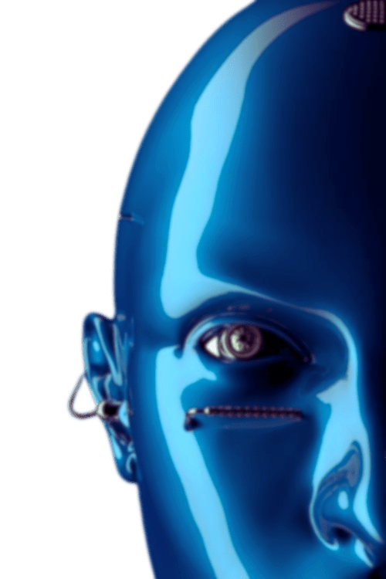

K.A.M.A.L.A
Kapidhwaj Association of Modern logic, Automation, Learning and career Advancement
PROBLEM STATEMENT
(Mental Health Check-In Agent)
A Personalized AI-Driven Mental Health Check-In System for Meaningful, Automated Well-being Support)
PRESENTED BY:
PRESENTED TO:
AARUSHI GARG
Ai Agents Workshop - Mini Hackathon
Kapidhwaj Innovations Pvt Ltd

Slide 2
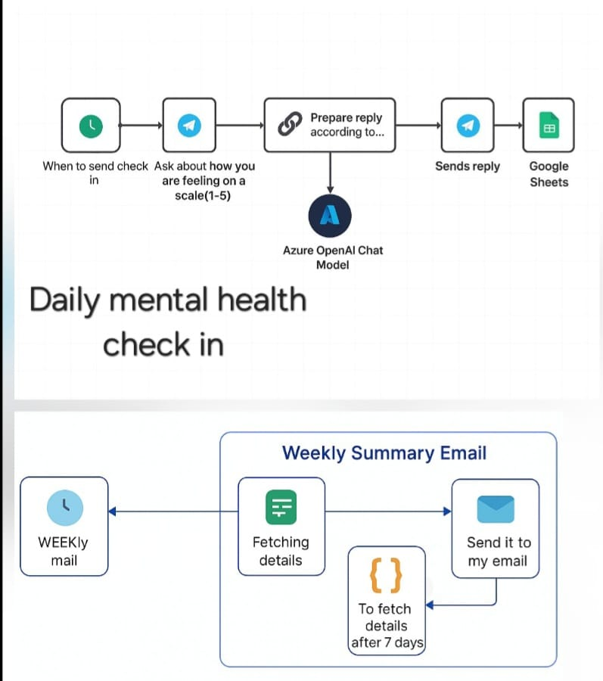
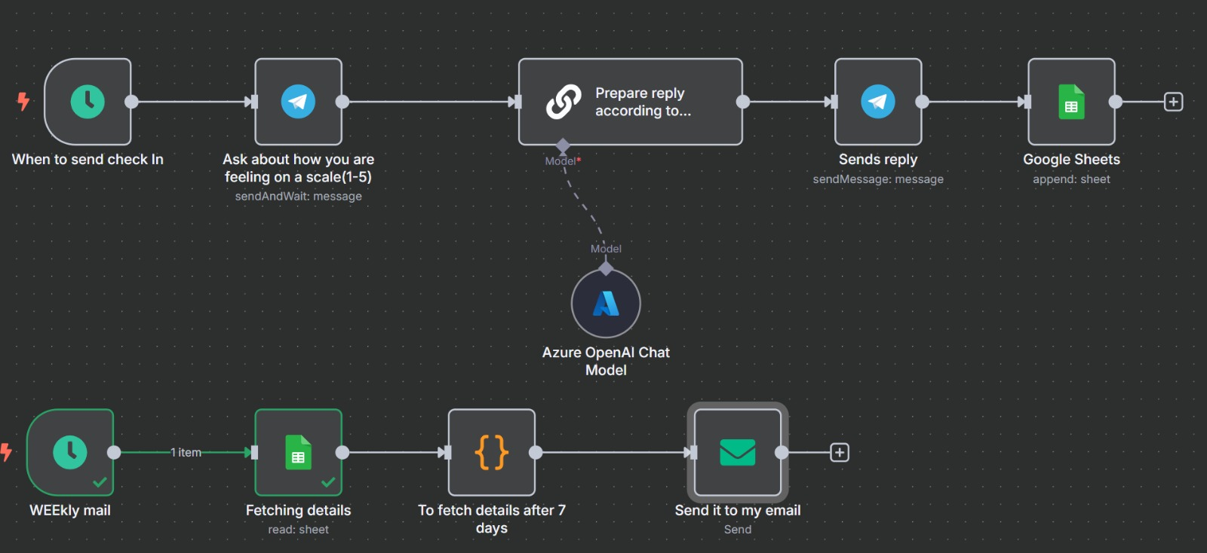
K.A.M.A.L.A
Kapidhwaj Association of Modern logic, Automation, Learning and career Advancement
WORKFLOW DIAGRAM

Slide 3
K.A.M.A.L.A
Kapidhwaj Association of Modern logic, Automation, Learning and career Advancement
USE CASE
In today’s fast-paced and digitally connected world, individuals often struggle to consistently monitor their mental health. Traditional support systems lack immediacy, privacy, and regular engagement—especially for remote teams, students, and individuals hesitant to seek help.
Target Users:
Remote employees & distributed teams
Students in educational institutions
Individuals with anxiety or mood disorders
HR and wellness departments
Digital wellness platforms
Feature | Description
Automated Daily Check-Ins | Sends a daily Telegram message asking how the user feels on a scale of 1–5
AI Response Generation | Azure OpenAI analyzes responses and crafts personalized, empathetic replies
Mood Logging (Google Sheets) | Tracks daily mood scores, timestamps, and responses
Weekly Insights via Email | Sends a summary of weekly mood trends for reflection or analysis

Slide 4
K.A.M.A.L.A
Kapidhwaj Association of Modern logic, Automation, Learning and career Advancement
ADVANTAGES
💬 1. Seamless Daily Engagement
Automates regular mood check-ins via Telegram
Encourages emotional self-awareness effortlessly
🤖 2. Empathetic AI Responses
Delivers thoughtful, non-judgmental replies
Personalized support using Azure OpenAI models
📊 3. Real-Time Mood Tracking
Logs responses in Google Sheets instantly
Enables long-term trend visualization & analysis
📨 4. Weekly Summaries for Insights
Sends concise email reports with 7-day mood data
Supports reflection, progress tracking, and early alerts
🔒 5. Privacy-First and Non-Intrusive
No human monitoring required
Safe space for users to express how they feel
⚙️ 6. Scalable & Customizable Workflow
Built on open-source n8n – fully flexible
Easy to integrate with other tools (Slack, Email, etc.)

Slide 5
K.A.M.A.L.A
Kapidhwaj Association of Modern logic, Automation, Learning and career Advancement
FUTURE SCOPE
📱 1. Multi-Platform Integration
Expand beyond Telegram to WhatsApp, Slack, Discord, MS Teams, and mobile apps
Reach users wherever they feel most comfortable
🎙️ 2. Voice-Based Check-Ins
Integrate with voice assistants like Alexa, Google Assistant
Enable hands-free emotional check-ins for enhanced accessibility
🧠 3. Advanced Sentiment Analysis
Go beyond numeric scores by analyzing free-text emotional input
Use NLP to detect deeper emotional cues and mental health risks
📈 4. Mental Health Dashboards
Visualize mood trends, peak stress days, and wellness progress
Custom dashboards for users, therapists, or HR teams
🧬 5. Personalized Wellness Suggestions
Recommend guided meditations, self-care tips, breathing exercises, or articles
Tailored to user mood and behavioral patterns

Slide 6
K.A.M.A.L.A
Kapidhwaj Association of Modern logic, Automation, Learning and career Advancement
WORKFLOW SUMMARY
Trigger: Scheduled daily check-in
Interaction: Telegram bot asks mood score (1–5)
Processing: Azure OpenAI generates a response based on input
Storage: Logs data in Google Sheets
Report: Weekly summary email shows trends and flags low moods
Thank You !

